Slide 1
Image Classification
Adithya Iyer – asi200000
Parvinder Singh- pxs200113

Slide 2
BRIEF OVERVIEW
Datasets Used
MNIST
Fashion-MNIST
CIFAR-100
Models Constructed
LeNet-5
AlexNet
VGG16
GoogleNet(Inception)
APNet – experimental original

Slide 3
Exploratory Analaysis

Slide 4
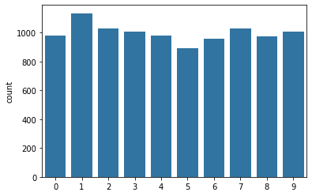
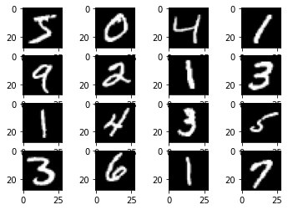
MNIST Dataset
Data Distribution
Sample Data

Slide 5
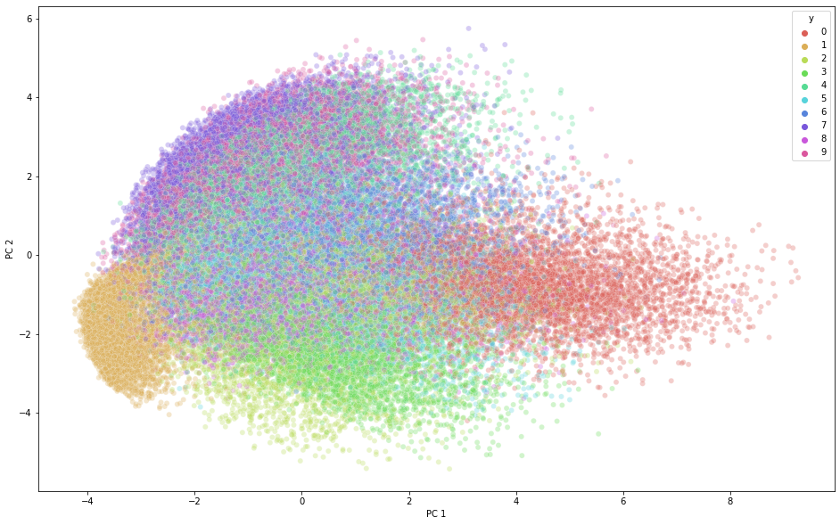
MNIST Dataset: PCA

Slide 6
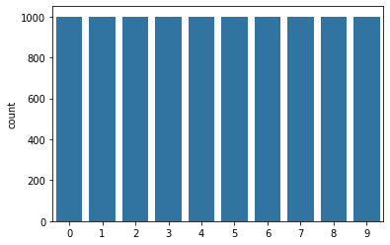
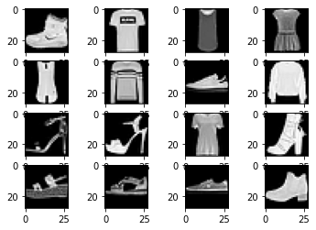
Fashion-MNIST Dataset
Data Distribution
Sample Data

Slide 7
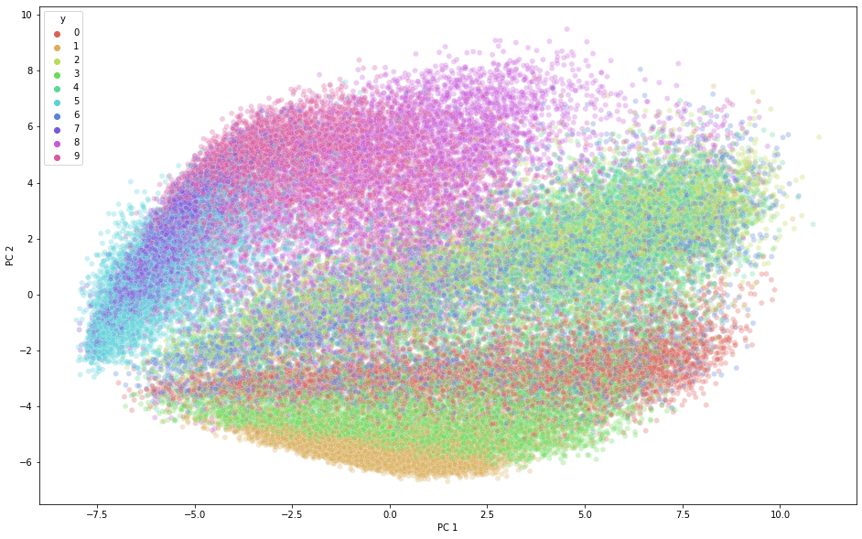
Fashion-MNIST Dataset: PCA

Slide 8
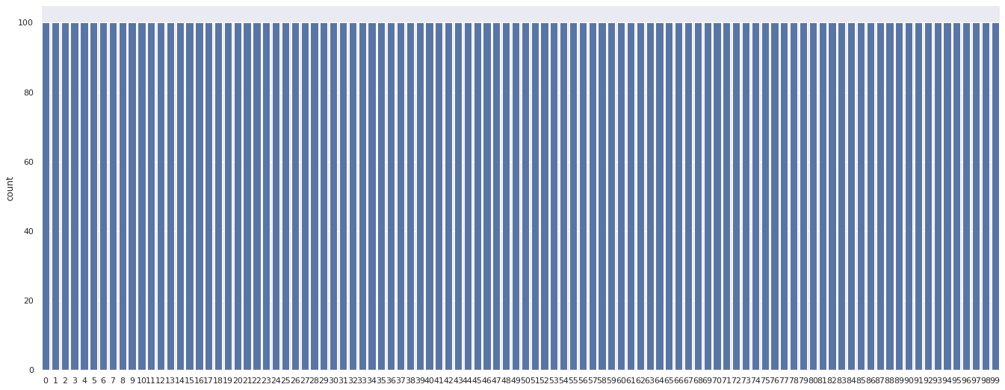
CIFAR-100 Dataset: Data Distribution

Slide 9
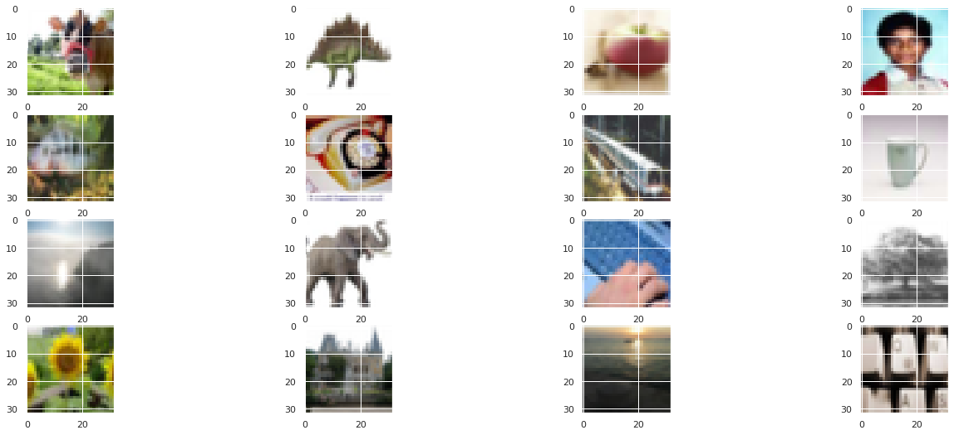
CIFAR-100 Dataset: Sample Data

Slide 10
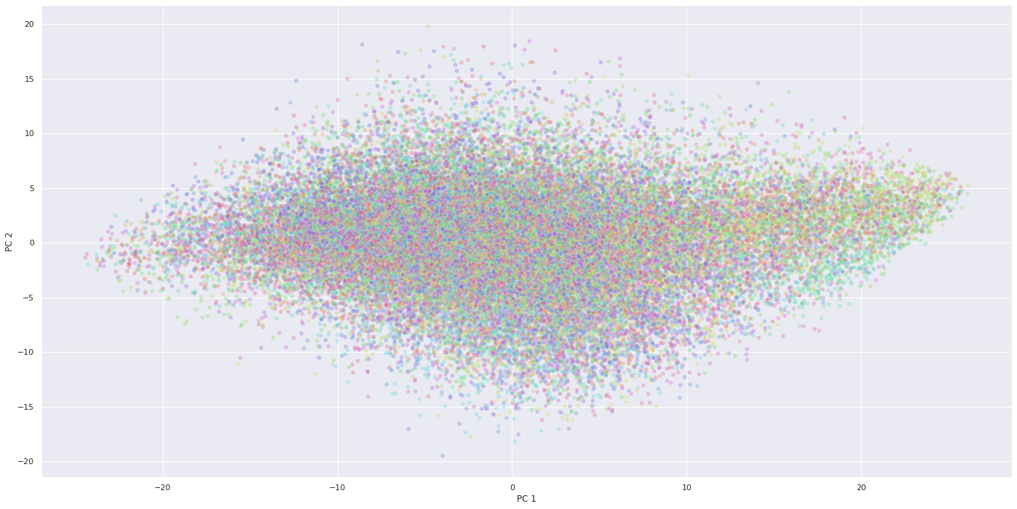
CIFAR-100 Dataset: PCA

Slide 11
STEPS IN IMAGE PROCESSING
Exploratory Data Analysis
Data pre-processing
Creating training, validation, test splits
Studying/creating cnn architecture and coding it appropriately
Hyperparameter Tuning
Number of epochs (<=50)
Learning rate η or γ (0.001-0.1)
Momentum μ (0.6-0.9)
Running finalized model with tuned hyperparameters
Comparison of model performance for different datasets
Comparison between different models on same dataset

Slide 12
CNN MODEL ARCHITECTURES

Slide 13


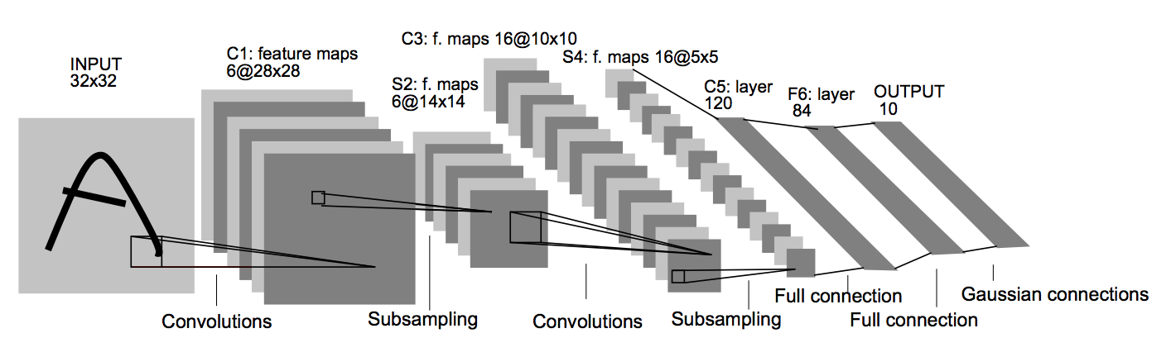
LeNet-5 Architecture

Slide 14
LeNet-5 Implementation
_________________________________________________________________
Layer (type) Output Shape Param #
=================================================================
input_1 (InputLayer) [(None, 28, 28, 1)] 0
conv2d (Conv2D) (None, 28, 28, 6) 156
average_pooling2d (AverageP (None, 14, 14, 6) 0
ooling2D)
conv2d_1 (Conv2D) (None, 14, 14, 16) 2416
average_pooling2d_1 (Averag (None, 7, 7, 16) 0
ePooling2D)
conv2d_2 (Conv2D) (None, 7, 7, 120) 48120
flatten (Flatten) (None, 5880) 0
dense (Dense) (None, 84) 494004
dense_1 (Dense) (None, 10) 850
=================================================================
Total params: 545,546
Trainable params: 545,546
Non-trainable params: 0
_________________________________________________________________

Slide 15
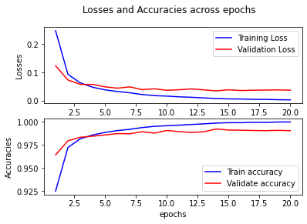
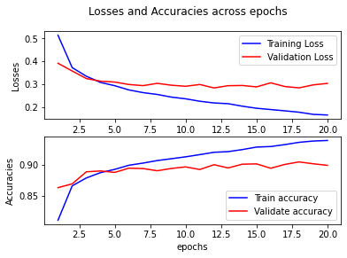
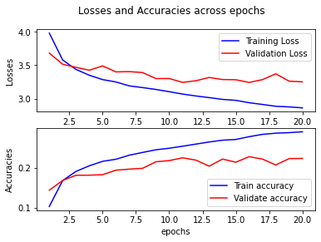
LeNet-5 Performance
MNIST
Test Accuracy = 99.03%
Fashion-MNIST
Test Accuracy = 89.43%
CIFAR-100
Test Accuracy = 23.77%

Slide 16
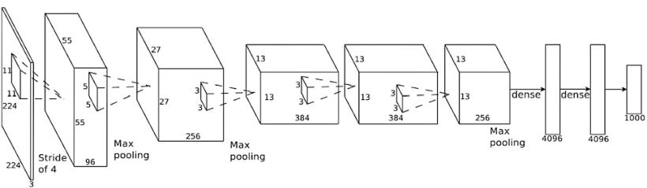
AlexNet Architecture

Slide 17
AlexNet Implementation
_________________________________________________________________
Layer (type) Output Shape Param #
=================================================================
input_13 (InputLayer) [(None, 28, 28, 1)] 0
conv2d_57 (Conv2D) (None, 7, 7, 96) 11712
max_pooling2d_35 (MaxPoolin (None, 4, 4, 96) 0
g2D)
batch_normalization_23 (Bat (None, 4, 4, 96) 384
chNormalization)
conv2d_58 (Conv2D) (None, 4, 4, 256) 614656
max_pooling2d_36 (MaxPoolin (None, 2, 2, 256) 0
g2D)
batch_normalization_24 (Bat (None, 2, 2, 256) 1024
chNormalization)
conv2d_59 (Conv2D) (None, 2, 2, 384) 885120
conv2d_60 (Conv2D) (None, 2, 2, 384) 1327488
conv2d_61 (Conv2D) (None, 2, 2, 256) 884992
max_pooling2d_37 (MaxPoolin (None, 1, 1, 256) 0
g2D)
dropout_22 (Dropout) (None, 1, 1, 256) 0
flatten_11 (Flatten) (None, 256) 0
dense_42 (Dense) (None, 4096) 1052672
dropout_23 (Dropout) (None, 4096) 0
dense_43 (Dense) (None, 4096) 16781312
dense_44 (Dense) (None, 1000) 4097000
dense_45 (Dense) (None, 10) 10010
=================================================================
Total params: 25,666,370
Trainable params: 25,665,666
Non-trainable params: 704
_________________________________________________________________

Slide 18
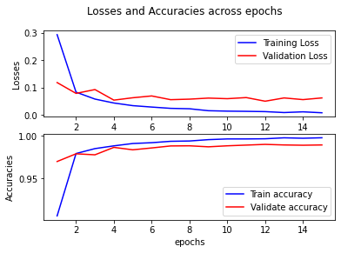
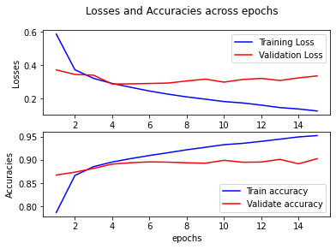
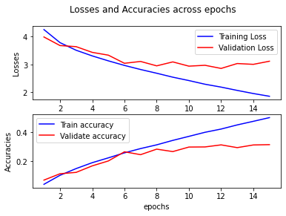
AlexNet Performance
MNIST
Test Accuracy = 98.90%
Fashion-MNIST
Test Accuracy = 89.51%
CIFAR-100
Test Accuracy = 32.33%

Slide 19
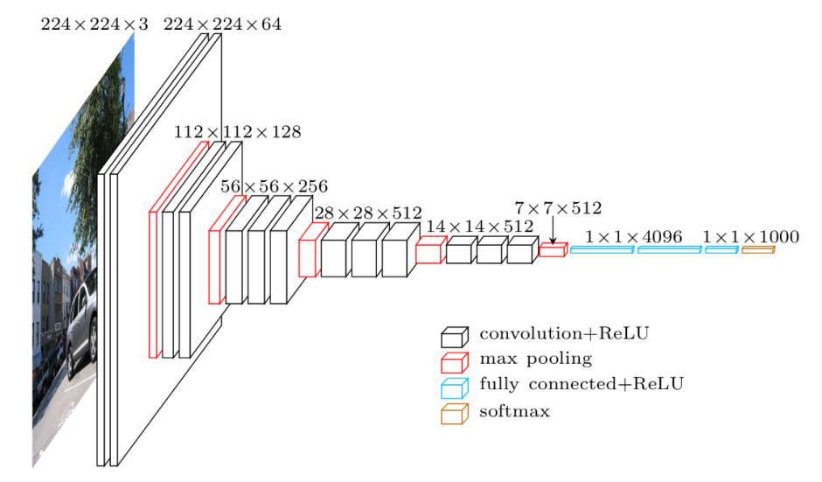
VGG16 Architecture

Slide 20
VGG16 Implementation
_________________________________________________________________
Layer (type) Output Shape Param #
=================================================================
input_11 (InputLayer) [(None, 28, 28, 1)] 0
conv2d_130 (Conv2D) (None, 28, 28, 64) 640
conv2d_131 (Conv2D) (None, 28, 28, 64) 36928
max_pooling2d_50 (MaxPoolin (None, 14, 14, 64) 0
g2D)
conv2d_132 (Conv2D) (None, 14, 14, 128) 73856
conv2d_133 (Conv2D) (None, 14, 14, 128) 147584
max_pooling2d_51 (MaxPoolin (None, 7, 7, 128) 0
g2D)
conv2d_134 (Conv2D) (None, 7, 7, 256) 295168
conv2d_135 (Conv2D) (None, 7, 7, 256) 590080
conv2d_136 (Conv2D) (None, 7, 7, 256) 590080
max_pooling2d_52 (MaxPoolin (None, 4, 4, 256) 0
g2D)
conv2d_137 (Conv2D) (None, 4, 4, 512) 1180160
conv2d_138 (Conv2D) (None, 4, 4, 512) 2359808
conv2d_139 (Conv2D) (None, 4, 4, 512) 2359808
max_pooling2d_53 (MaxPoolin (None, 2, 2, 512) 0
g2D)
conv2d_140 (Conv2D) (None, 2, 2, 512) 2359808
conv2d_141 (Conv2D) (None, 2, 2, 512) 2359808
conv2d_142 (Conv2D) (None, 2, 2, 512) 2359808
max_pooling2d_54 (MaxPoolin (None, 1, 1, 512) 0
g2D)
flatten_10 (Flatten) (None, 512) 0
dense_32 (Dense) (None, 4096) 2101248
dense_33 (Dense) (None, 4096) 16781312
dense_34 (Dense) (None, 10) 40970
=================================================================
Total params: 33,637,066
Trainable params: 33,637,066
Non-trainable params: 0
_________________________________________________________________

Slide 21
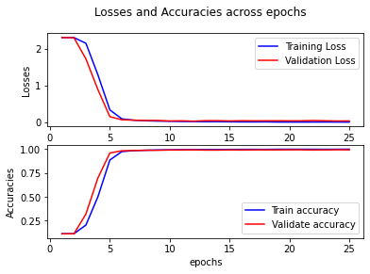
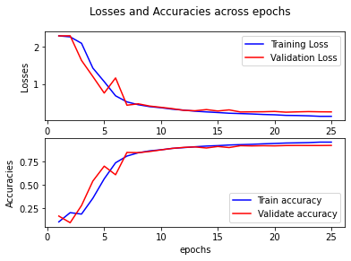
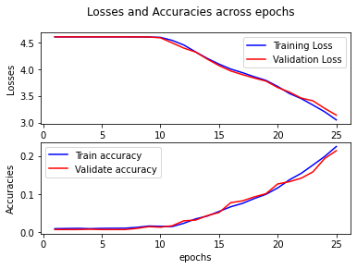
VGG16 Performance
MNIST
Test Accuracy = 99.36%
Fashion-MNIST
Test Accuracy = 92.16%
CIFAR-100
Test Accuracy = 22.93%

Slide 22
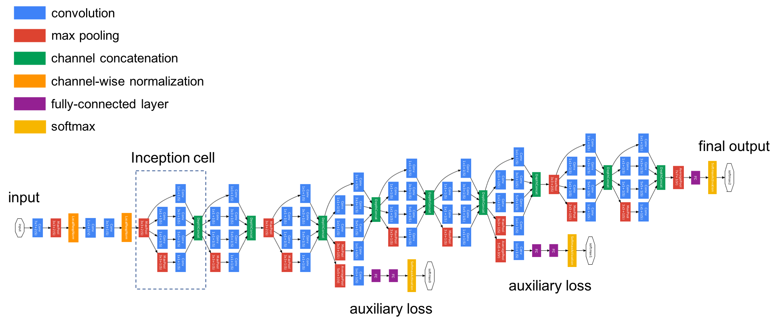
GoogLeNet(Inception)
Architecture

Slide 23
GoogLeNet(Inception) Implementation
_________________________________________________________________
Layer (type) Output Shape Param # Connected to
=================================================================
input_1 (InputLayer) [(None, 28, 28, 1)] 0 []
conv2d (Conv2D) (None, 14, 14, 64) 3200 ['input_1[0][0]']
max_pooling2d (MaxPooling2D) (None, 7, 7, 64) 0 ['conv2d[0][0]']
batch_normalization (BatchNorm (None, 7, 7, 64) 256 ['max_pooling2d[0][0]']
alization)
conv2d_1 (Conv2D) (None, 7, 7, 64) 4160 ['batch_normalization[0][0]']
conv2d_2 (Conv2D) (None, 7, 7, 192) 110784 ['conv2d_1[0][0]']
batch_normalization_1 (BatchNo (None, 7, 7, 192) 768 ['conv2d_2[0][0]']
rmalization)
max_pooling2d_1 (MaxPooling2D) (None, 4, 4, 192) 0 ['batch_normalization_1[0][0]']
conv2d_3 (Conv2D) (None, 4, 4, 64) 12352 ['max_pooling2d_1[0][0]']
conv2d_4 (Conv2D) (None, 4, 4, 128) 221312 ['max_pooling2d_1[0][0]']
conv2d_5 (Conv2D) (None, 4, 4, 128) 614528 ['max_pooling2d_1[0][0]']
max_pooling2d_2 (MaxPooling2D) (None, 4, 4, 192) 0 ['max_pooling2d_1[0][0]']
concatenate (Concatenate) (None, 4, 4, 512) 0 ['conv2d_3[0][0]',
'conv2d_4[0][0]',
'conv2d_5[0][0]',
'max_pooling2d_2[0][0]']
conv2d_6 (Conv2D) (None, 4, 4, 128) 65664 ['concatenate[0][0]']
conv2d_7 (Conv2D) (None, 4, 4, 192) 884928 ['concatenate[0][0]']
conv2d_8 (Conv2D) (None, 4, 4, 192) 2457792 ['concatenate[0][0]']
max_pooling2d_3 (MaxPooling2D) (None, 4, 4, 512) 0 ['concatenate[0][0]']
concatenate_1 (Concatenate) (None, 4, 4, 1024) 0 ['conv2d_6[0][0]',
'conv2d_7[0][0]',
'conv2d_8[0][0]',
'max_pooling2d_3[0][0]']
max_pooling2d_4 (MaxPooling2D) (None, 2, 2, 1024) 0 ['concatenate_1[0][0]']
conv2d_9 (Conv2D) (None, 2, 2, 192) 196800 ['max_pooling2d_4[0][0]']

Slide 24
GoogLeNet(Inception) Implementation – contd.
conv2d_10 (Conv2D) (None, 2, 2, 208) 1917136 ['max_pooling2d_4[0][0]']
conv2d_11 (Conv2D) (None, 2, 2, 208) 5325008 ['max_pooling2d_4[0][0]']
max_pooling2d_5 (MaxPooling2D) (None, 2, 2, 1024) 0 ['max_pooling2d_4[0][0]']
concatenate_2 (Concatenate) (None, 2, 2, 1632) 0 ['conv2d_9[0][0]',
'conv2d_10[0][0]',
'conv2d_11[0][0]',
'max_pooling2d_5[0][0]’]
conv2d_13 (Conv2D) (None, 2, 2, 160) 261280 ['concatenate_2[0][0]']
conv2d_14 (Conv2D) (None, 2, 2, 224) 3290336 ['concatenate_2[0][0]']
conv2d_15 (Conv2D) (None, 2, 2, 224) 9139424 ['concatenate_2[0][0]']
max_pooling2d_6 (MaxPooling2D) (None, 2, 2, 1632) 0 ['concatenate_2[0][0]']
concatenate_3 (Concatenate) (None, 2, 2, 2240) 0 ['conv2d_13[0][0]',
'conv2d_14[0][0]',
'conv2d_15[0][0]',
'max_pooling2d_6[0][0]']
conv2d_16 (Conv2D) (None, 2, 2, 128) 286848 ['concatenate_3[0][0]']
conv2d_17 (Conv2D) (None, 2, 2, 256) 5161216 ['concatenate_3[0][0]']
conv2d_18 (Conv2D) (None, 2, 2, 256) 14336256 ['concatenate_3[0][0]']
max_pooling2d_7 (MaxPooling2D) (None, 2, 2, 2240) 0 ['concatenate_3[0][0]']
concatenate_4 (Concatenate) (None, 2, 2, 2880) 0 ['conv2d_16[0][0]',
'conv2d_17[0][0]',
'conv2d_18[0][0]',
'max_pooling2d_7[0][0]’]
conv2d_19 (Conv2D) (None, 2, 2, 112) 322672 ['concatenate_4[0][0]']
conv2d_20 (Conv2D) (None, 2, 2, 288) 7465248 ['concatenate_4[0][0]']
conv2d_21 (Conv2D) (None, 2, 2, 288) 20736288 ['concatenate_4[0][0]’]
max_pooling2d_8 (MaxPooling2D) (None, 2, 2, 2880) 0 ['concatenate_4[0][0]’]

Slide 25
GoogLeNet(Inception) Implementation – contd.
concatenate_5 (Concatenate) (None, 2, 2, 3568) 0 ['conv2d_19[0][0]',
'conv2d_20[0][0]',
'conv2d_21[0][0]',
'max_pooling2d_8[0][0]']
conv2d_22 (Conv2D) (None, 2, 2, 256) 913664 ['concatenate_5[0][0]']
conv2d_23 (Conv2D) (None, 2, 2, 320) 10276160 ['concatenate_5[0][0]']
conv2d_24 (Conv2D) (None, 2, 2, 320) 28544320 ['concatenate_5[0][0]']
max_pooling2d_9 (MaxPooling2D) (None, 2, 2, 3568) 0 ['concatenate_5[0][0]']
concatenate_6 (Concatenate) (None, 2, 2, 4464) 0 ['conv2d_22[0][0]',
'conv2d_23[0][0]',
'conv2d_24[0][0]',
'max_pooling2d_9[0][0]']
average_pooling2d (AveragePool (None, 1, 1, 1632) 0 ['concatenate_2[0][0]']
ing2D)
average_pooling2d_1 (AveragePo (None, 1, 1, 4464) 0 ['concatenate_6[0][0]']
oling2D)
conv2d_12 (Conv2D) (None, 1, 1, 128) 209024 ['average_pooling2d[0][0]']
conv2d_25 (Conv2D) (None, 1, 1, 128) 571520 ['average_pooling2d_1[0][0]']
average_pooling2d_2 (AveragePo (None, 4, 4, 1024) 0 ['concatenate_1[0][0]']
oling2D)
flatten (Flatten) (None, 128) 0 ['conv2d_12[0][0]']
flatten_1 (Flatten) (None, 128) 0 ['conv2d_25[0][0]']
flatten_2 (Flatten) (None, 16384) 0 ['average_pooling2d_2[0][0]']
dense (Dense) (None, 1024) 132096 ['flatten[0][0]']
dense_1 (Dense) (None, 1024) 132096 ['flatten_1[0][0]']
dropout_2 (Dropout) (None, 16384) 0 ['flatten_2[0][0]']
dropout (Dropout) (None, 1024) 0 ['dense[0][0]']
dropout_1 (Dropout) (None, 1024) 0 ['dense_1[0][0]']
dense_2 (Dense) (None, 10) 163850 ['dropout_2[0][0]']
aux1 (Dense) (None, 10) 10250 ['dropout[0][0]']
aux2 (Dense) (None, 10) 10250 ['dropout_1[0][0]']

Slide 26
GoogLeNet(Inception) Implementation – contd.
=================================================================
Total params: 113,777,486
Trainable params: 113,776,974
Non-trainable params: 512
_________________________________________________________________

Slide 27
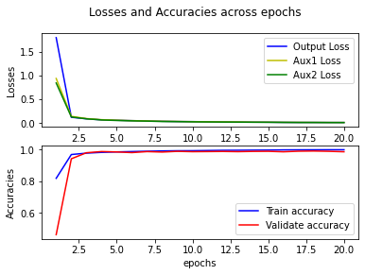
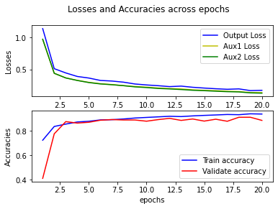
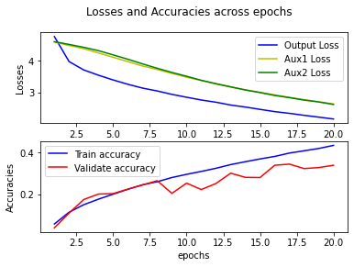
GoogLeNet(Inception) Performance
MNIST
Test Accuracy = 98.77%
Fashion-MNIST
Test Accuracy = 87.80%
CIFAR-100
Test Accuracy = 35.80%

Slide 28
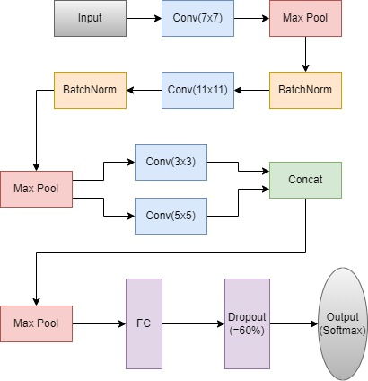
AP-Net Architecture

Slide 29
AP-Net Implementation
_________________________________________________________________
Layer (type) Output Shape Param # Connected to
=================================================================
input_1 (InputLayer) [(None, 32, 32, 3)] 0 []
conv2d (Conv2D) (None, 16, 16, 32) 4736 ['input_1[0][0]']
max_pooling2d (MaxPooling2D) (None, 8, 8, 32) 0 ['conv2d[0][0]']
batch_normalization (BatchNorm (None, 8, 8, 32) 128 ['max_pooling2d[0][0]']
alization)
conv2d_1 (Conv2D) (None, 4, 4, 64) 247872 ['batch_normalization[0][0]']
batch_normalization_1 (BatchNo (None, 4, 4, 64) 256 ['conv2d_1[0][0]']
rmalization)
max_pooling2d_1 (MaxPooling2D) (None, 2, 2, 64) 0 ['batch_normalization_1[0][0]']
conv2d_2 (Conv2D) (None, 2, 2, 16) 9232 ['max_pooling2d_1[0][0]']
conv2d_3 (Conv2D) (None, 2, 2, 16) 25616 ['max_pooling2d_1[0][0]']
concatenate (Concatenate) (None, 2, 2, 32) 0 ['conv2d_2[0][0]',
'conv2d_3[0][0]']
max_pooling2d_2 (MaxPooling2D) (None, 1, 1, 32) 0 ['concatenate[0][0]']
flatten (Flatten) (None, 32) 0 ['max_pooling2d_2[0][0]']
dense (Dense) (None, 1024) 33792 ['flatten[0][0]']
dropout (Dropout) (None, 1024) 0 ['dense[0][0]']
dense_1 (Dense) (None, 10) 10250 ['dropout[0][0]']
=================================================================
Total params: 331,882
Trainable params: 331,690
Non-trainable params: 192
_________________________________________________________________

Slide 30
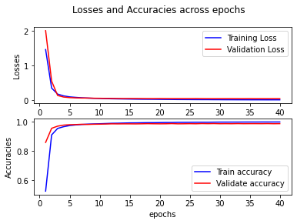
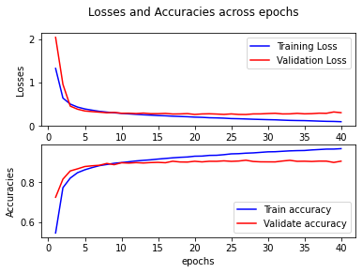
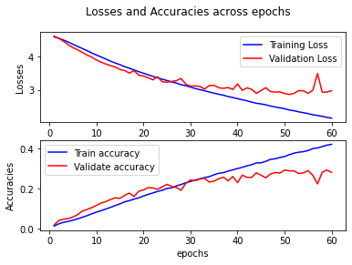
AP-Net Performance
MNIST
Test Accuracy = 99.09%
Fashion-MNIST
Test Accuracy = 89.39%
CIFAR-100
Test Accuracy = 28.13%

Slide 31
References
https://www.jeremyjordan.me/convnet-architectures/
http://yann.lecun.com/exdb/publis/pdf/lecun-98.pdf
https://www.nvidia.cn/content/tesla/pdf/machine-learning/imagenet-classification-with-deep-convolutional-nn.pdf
https://arxiv.org/abs/1409.1556
https://arxiv.org/abs/1409.4842
https://arxiv.org/abs/1512.00567

Slide 32
THANK YOU!
Any questions?

